Slide 1
Computer Networks
Unit 3
By
Dr. Vivek Rajpoot
Assistant Professor
Dept. of Electronics and Communication Engineering
Aditya College of Engineering & Technology
Surampalem

Slide 2
Flow of Discussion
Data Link Layer Design issues
Framing
Error Control
Error-Correcting Codes
Error Detecting Codes
Flow Control
Elementary Data Link Protocols-
Utopian Simplex Protocol
Simplex Stop and Wait Protocol for an Error free channel
Simplex Stop and Wait Protocol for a Noisy Channel, Sliding Window Protocols
One Bit Sliding Window Protocol
Protocol Using Go-Back-N- A Protocol Using Selective Repeat
Dr. Vivek Rajpoot
Unit-3

Slide 3
Data Link Layer Design issues
The data link layer has to do following functions:
Providing a well-defined service interface to the network layer.
Provides services for the reliable interchange of data across a data link established by the physical layer.
Link layer protocols manage the establishment, maintenance, and release of data-link connections.
Data-link protocols control the flow of data, dealing with transmission errors, and supervise data error recovery.
Regulating the flow of data so that slow receivers are not swamped by fast senders.
Determining how the bits of the physical layer are grouped into frames.
Recovery from abnormal conditions.
Dr. Vivek Rajpoot
Unit-3

Slide 4
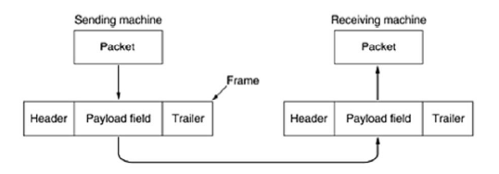
Data Link Layer Design issues
To accomplish these goals, the data link layer takes the packets it gets from the network layer and encapsulates them into frames for transmission.
Each frame contains a frame header, a payload field for holding the packet, and a frame trailer, as illustrated in Fig.
Dr. Vivek Rajpoot
Unit-3

Slide 5
Data Link Layer Design issues
Services Provided to the Network Layer:
Framing
Error Control
Flow Control
Dr. Vivek Rajpoot
Unit-3

Slide 6
Services Provided to the N/W Layer:
The function of the data link layer is to provide service to the network layer.
The principal service is transferring data from the network layer on the source machine to the network layer on the destination machine.
The data link layer can be designed to offer various services, Three possibilities that are commonly provided are:
1. Unacknowledged connectionless service (real-time traffic like speech)
It consists a source machine used to send independent frames to the destination machine without need of destination machine acknowledge.
2. Acknowledged connectionless service.
For sent frame an individually acknowledgement is sent. This way, the sender knows whether or not a frame has arrived safely. Good for unreliable channels, such as wireless.
3. Acknowledged connection-oriented service.
Guarantees that each frame is received at least once and all frames are received in the right order.
Dr. Vivek Rajpoot
Unit-3

Slide 7
Framing
Framing is a function of the data link layer. It provides a way for a sender to transmit a set of bits that are meaningful to the receiver.
Ethernet, token ring, frame relay, and other data link layer technologies have their own frame structures.
Frames have headers that contain information such as error-checking codes.
Problems in Framing:
Detecting start of the frame: When a frame is transmitted, every station must be able to detect it. Station detect frames by looking out for special sequence of bits that marks the beginning of the frame i.e. SFD (Starting Frame Delimeter).
How do station detect a frame: Every station listen to link for SFD pattern through a sequential circuit. If SFD is detected, sequential circuit alerts station. Station checks destination address to accept or reject frame.
Dr. Vivek Rajpoot
Unit-3

Slide 8
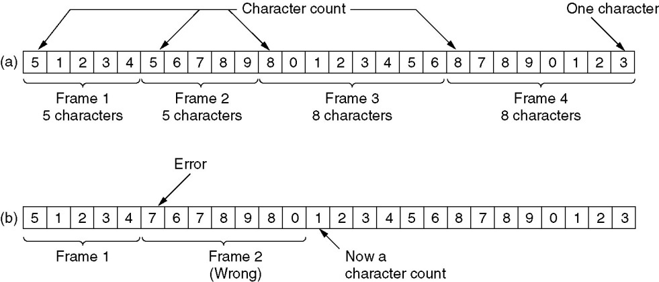
Framing Techniques
1. Character Count
2. Flag bytes with byte stuffing
3. Flag bytes with bit stuffing
Character Count:
Which uses a field in the header to specify the number of characters in the frame.
When the data link layer at the destination sees the character count, it knows how many characters follow.
What if the count is garbled
Even if with checksum, the receiver knows that the frame is bad there is no way to tell where the next frame starts.
Asking for retransmission doesn’t help either because the start of the retransmitted frame is not known
No longer used
Dr. Vivek Rajpoot
Unit-3

Slide 9
Flag bytes with byte stuffing
The second framing method gets around the problem of resynchronization after an error by having each frame start and end with special bytes
most protocols have used the same byte, called a flag byte, as both the starting and ending delimiter
Two consecutive flag bytes indicate the end of one frame and start of the next one.
A serious problem occurs with this method when binary data, such as object programs or floating-point numbers, are being transmitted. It may easily happen that the flag byte's bit pattern occurs in the data. This situation will usually interfere with the framing. One way to solve this problem is to have the sender's data link layer insert a special escape byte (ESC) just before each ''accidental'' flag byte in the data. The data link layer on the receiving end removes the escape byte before the data are given to the network layer. This technique is called byte stuffing or character stuffing.
Dr. Vivek Rajpoot
Unit-3

Slide 10
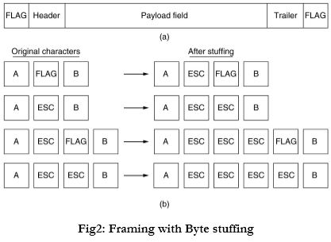
Flag bytes with byte stuffing
Dr. Vivek Rajpoot
Unit-3

Slide 11
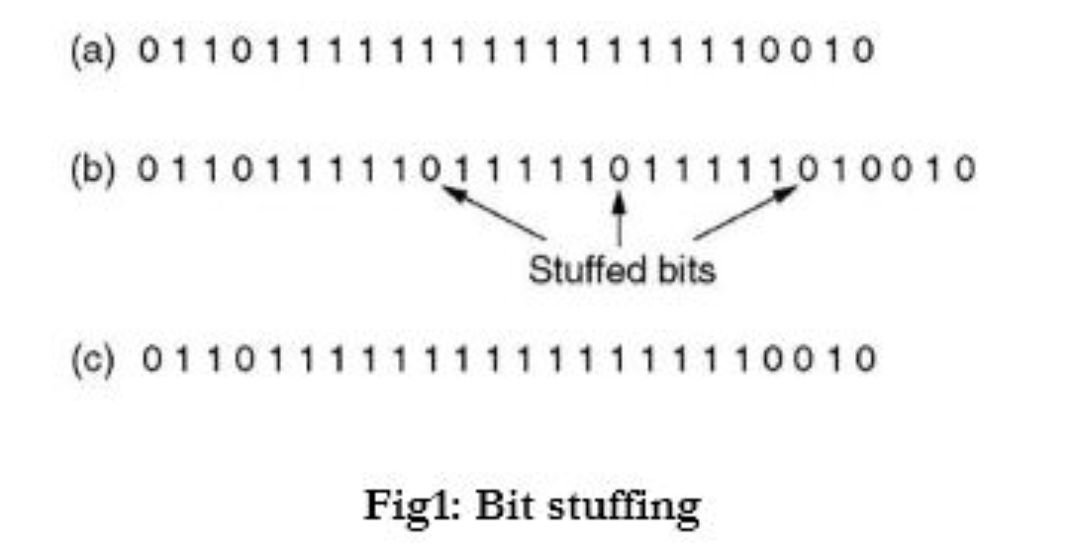
Bit Stuffing
Each frame begins and ends with a special bit pattern, 01111110 (in fact, a flag byte). Whenever the sender's data link layer encounters five consecutive 1s in the data, it automatically stuffs a 0 bit into the outgoing bit stream.
When the receiver sees five consecutive incoming 1 bits, followed by a 0 bit, it automatically de stuffs (i.e., deletes) the 0 bit.
Dr. Vivek Rajpoot
Unit-3

Slide 12
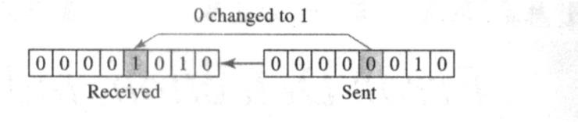
Error Control
TYPES OF ERRORS:
Whenever bits flow from one point to another, they are subject to unpredictable changes because of interference. This interference can change the shape of the signal; leads to an error in data transmission.
Basic types of errors are
i. Single-Bit Error
ii. Burst Error
i. Single-Bit Error
The term single-bit error means that only one bit of a given data unit (such as a byte, character, data unit, or packet) is changed from 1 to 0 or from 0 to 1. In a single-bit error, only one bit in the data unit has changed.
Dr. Vivek Rajpoot
Unit-3

Slide 13
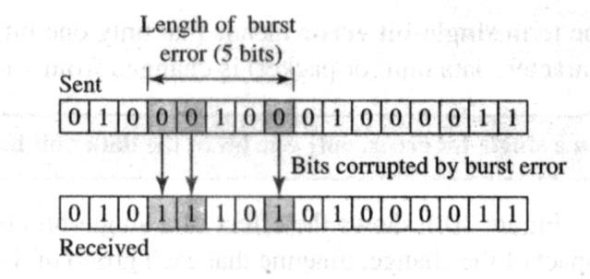
Error Control
2.Burst Error: The term burst error means that 2 or more bits in the data unit have changed from 1 to 0 or from 0 to 1.
Figure below shows the effect of a burst error on a data unit. In this case, 0100010001000011 was sent, but 0101110101000011 was received. Note that a burst error does not necessarily mean that the errors occur in consecutive bits. The length of the burst is measured from the first corrupted bit to the last corrupted bit. Some bits in between may not been corrupted.
Burst error is most likely to occur in a serial transmission
Dr. Vivek Rajpoot
Unit-3

Slide 14
Error Control
There are 2 Error Control method
Error Detection
Error Correction
Error Detection: Most networking equipment at the data-link layer inserts some type of error-detection code. When a frame arrives at the next hop in the transmission sequence, the receiving hop extracts the error-detection code and applies it to the frame. When an error is detected, the message is normally discarded. In this case, the sender of the erroneous message is notified.
Dr. Vivek Rajpoot
Unit-3

Slide 15
Redundancy
Error detection uses the concept of redundancy, which means adding extra bits for detecting errors at the destination. This technique is called redundancy because the extra bits are redundant to the information; they are discarded as soon as the accuracy of the transmission has been determined.
Once the data stream has been generated, it passes through a device that analyzes it and adds on an appropriately coded data unit, now enlarged by several bits, travels over the link to the receiver. The receiver puts the entire stream through a checking function, if the received bit stream passes the checking criteria the data portion of the data unit is accepted and the redundant bits are discarded.
Dr. Vivek Rajpoot
Unit-3

Slide 16
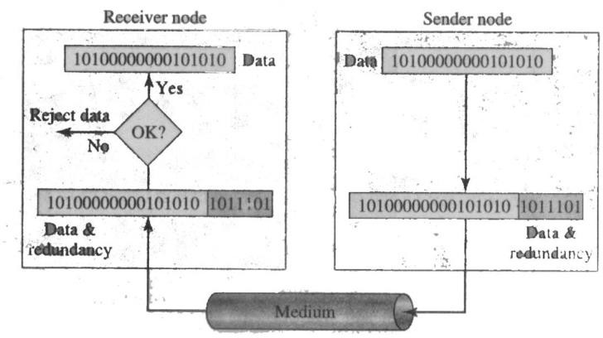
Redundancy
Dr. Vivek Rajpoot
Unit-3

Slide 17
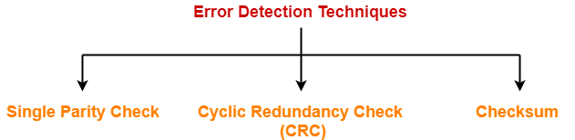
Error Detection
Three types of Error Detection Method:
Simple Parity Check:
In this technique, a redundant bit, called a parity bit added so that the total number of 1s in the unit (including the parity bit) becomes even (or odd).
Suppose we want to transmit the binary data unit 1100001. Before transmitting we pass the data unit through a parity generator. The parity generator counts the 1’s and appends the parity bit (a 1 in this case end. The total number of 1 is now 4 an even number. The system now transmits the entire expanded unit across the network link.
Dr. Vivek Rajpoot
Unit-3

Slide 18
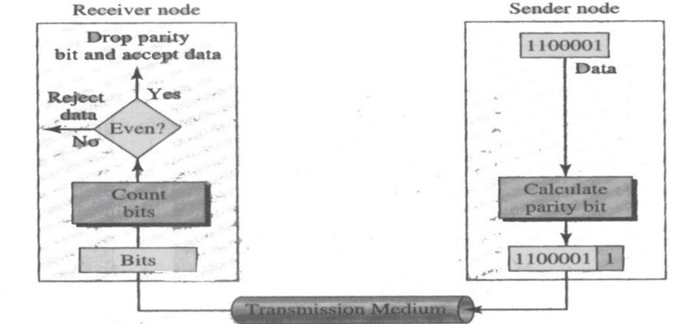
Simple Parity Check
At the Rx checks bits through an even-parity checking function. If Rx sees 11000011, it counts four is, an even number, and the data unit passes. But if the data unit has been damaged in transit, suppose the receiver sees 11001011. Then parity checker counts the 1s as 5, an odd number. Rx now knows that an error has been introduced into the data somewhere and therefore rejects the whole unit.
Dr. Vivek Rajpoot
Unit-3

Slide 19
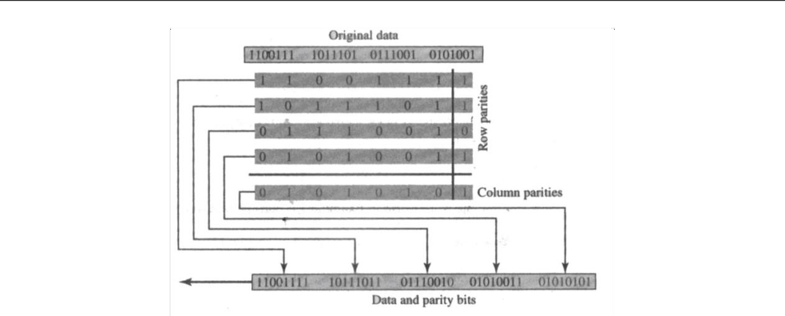
Two Dimensional Parity Check
A better approach is the two dimensional parity check. In this method, block of bits is organized as a table (rows and columns). First we calculate the parity bit for each data unit. Then we organize them into a table format.
Dr. Vivek Rajpoot
Unit-3

Slide 20
Cyclic Redundancy Check (CRC)
The most powerful of the redundancy checking techniques is CRC.
Unlike the parity check which is based on addition, CRC is based on binary division.
In CRC, a sequence of redundant bits, the CRC remainder, is appended to the end of a data unit so that the resulting data unit becomes exactly divisible by a second, predetermined binary number.
At destination, the incoming data unit is divided by the same number.
If at this step there is no remainder the data unit is assumed to be intact and is therefore accepted.
A remainder indicates that the data unit has been damaged in transmit therefore must be rejected.
Dr. Vivek Rajpoot
Unit-3

Slide 21
Cyclic Redundancy Check (CRC)
The redundant bits used by CRC are derived by dividing the data unit by a pre determined divisor; the remainder is the CRC.
Steps in CRC:
A string of n 0s is appended to the data unit. The number n is 1 less than the number of bits in the predetermined divisor, which is n+1 bit.
The new data unit is divided by the divisor, using a process called binary division. The remainder resulting from this division is the CRC.
The CRC of n bits derived in step 2 replaces the appended 0s at the end of the data unit. Note that the CRC may consist of all 0s.
Dr. Vivek Rajpoot
Unit-3

Slide 22
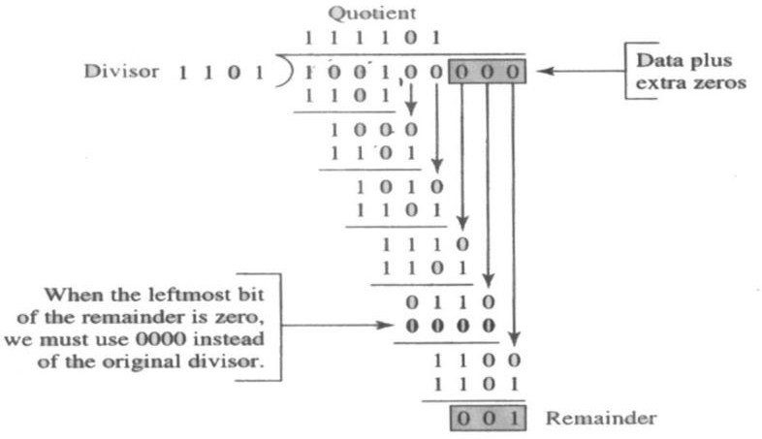
Cyclic Redundancy Check (CRC)
Dr. Vivek Rajpoot
Unit-3

Slide 23
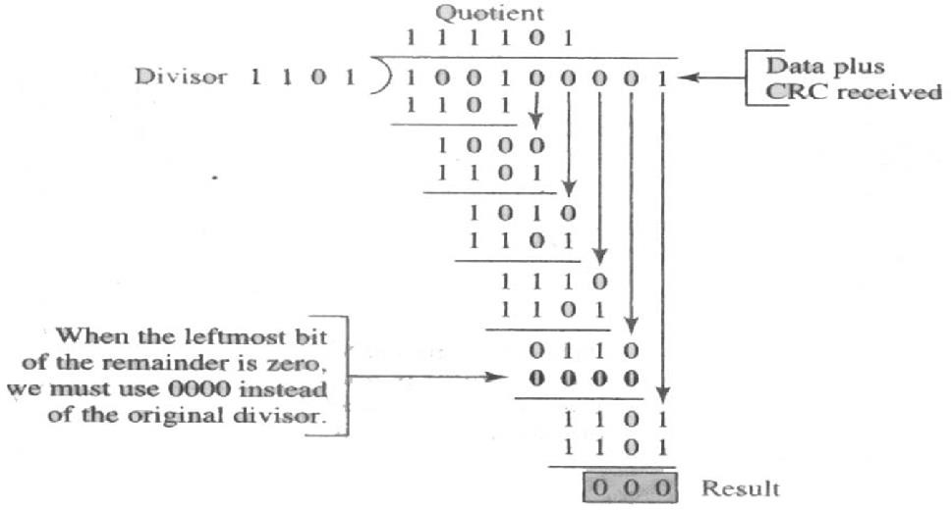
Cyclic Redundancy Check (CRC)
Dr. Vivek Rajpoot
Unit-3

Slide 24
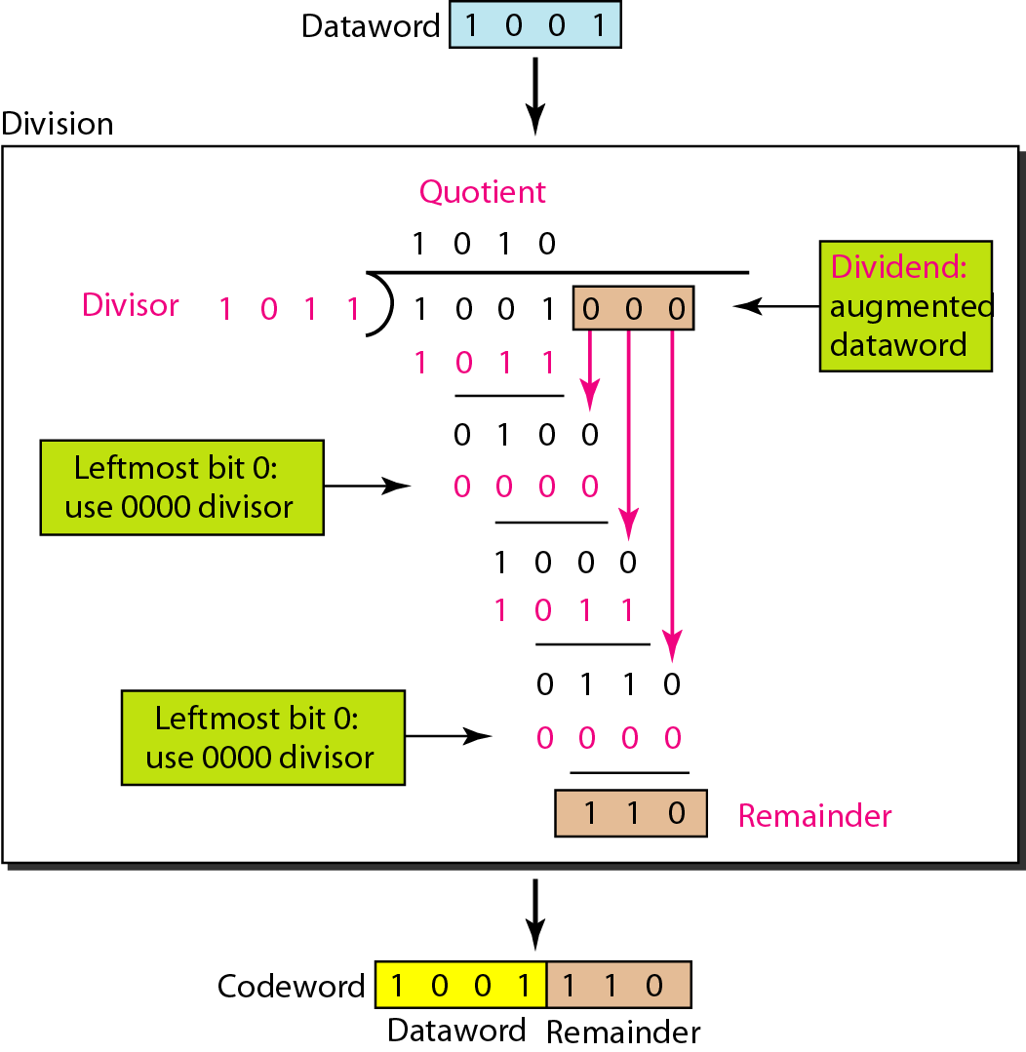
Cyclic Redundancy Check (CRC)
Dr. Vivek Rajpoot
Unit-3

Slide 25
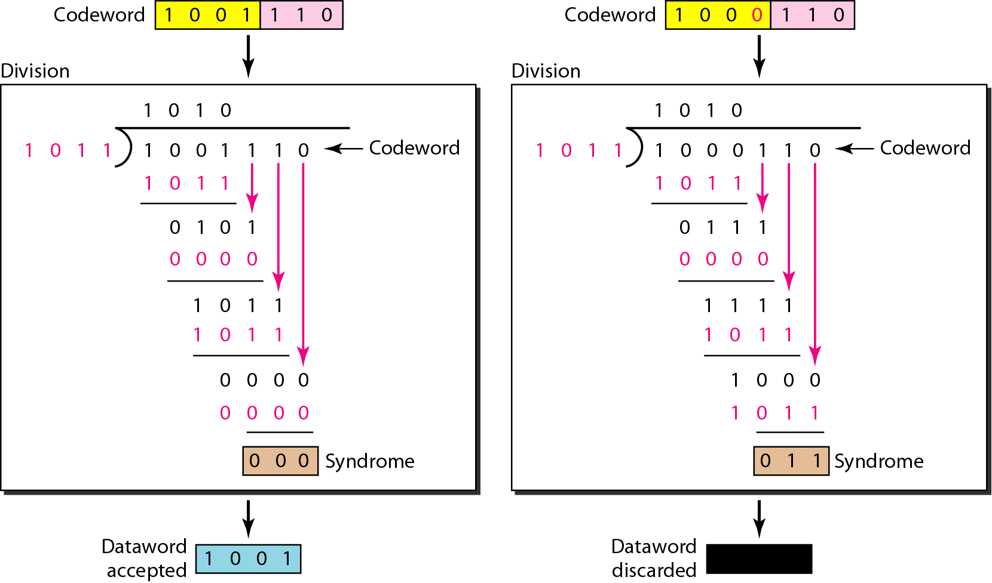
Cyclic Redundancy Check (CRC)
Dr. Vivek Rajpoot
Unit-3

Slide 26
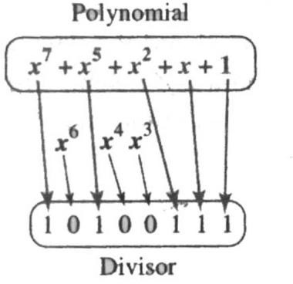
Polynomials
The divisor in the CRC generator is most often represented not as a string of 1s and 0s, but as an algebraic polynomial, like (x^7)+(x^5)+(x^2)+x+1
The polynomial format is useful for two reasons: It is short, and it can be used to prove the concept mathematically.
A polynomial should be selected to have at least the following properties:
It should not be divisible by x.
It should be divisible by x + 1.
Dr. Vivek Rajpoot
Unit-3

Slide 27
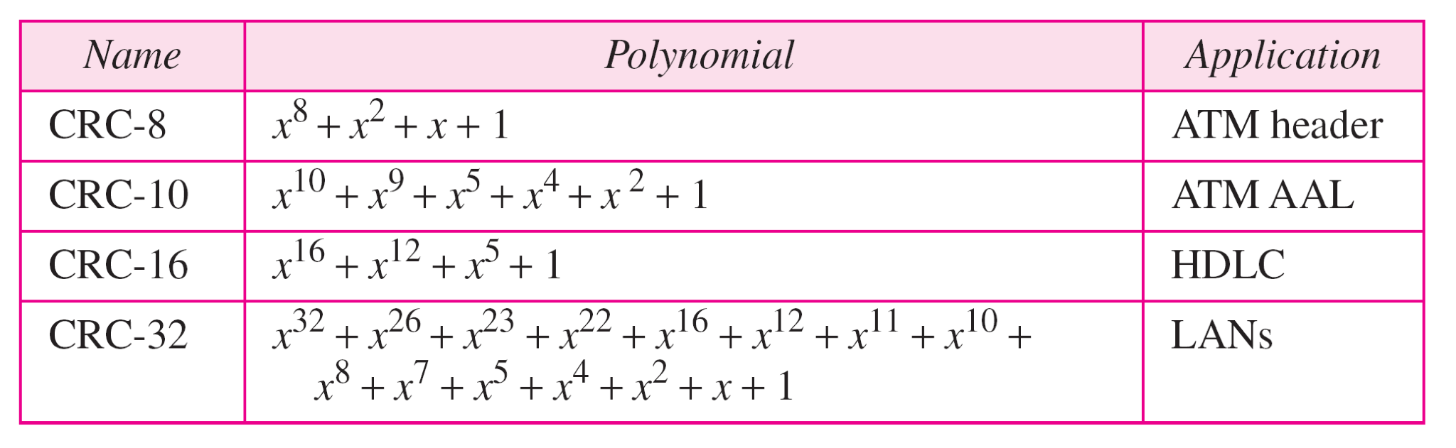
Standard Polynomials
Dr. Vivek Rajpoot
Unit-3

Slide 28
CHECKSUM
Like the parity checks and CRC, the checksum is based on the concept of redundancy.
Checksum Generator
In the sender, the checksum generator did the following actions.
The unit is subdivided into k sections, each of n bits.
All these k sections are added using ones complement arithmetic in such a way that the total is also n bits long.
The sum is complemented and appended to the end of the original data unit as redundancy bits, called the checksum field
The extended data unit is transmitted across the network. So, if the sum of the data segment is T, the checksum will be -T.
Checksum Checker
The receiver follows these steps
The unit is divided into k sections, each of n bits as the checksum generation.
All sections are added using ones complement to get the sum.
The sum is complemented.
If the result is zero, the data are accepted: otherwise, they are rejected.
Dr. Vivek Rajpoot
Unit-3

Slide 29
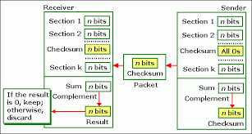
CHECKSUM
Example: Suppose the following block of 16 bits is to be sent using a checksum of 8 bits. 10101001 00111001
The numbers are added using ones complement arithmetic
Dr. Vivek Rajpoot
Unit-3

Slide 30
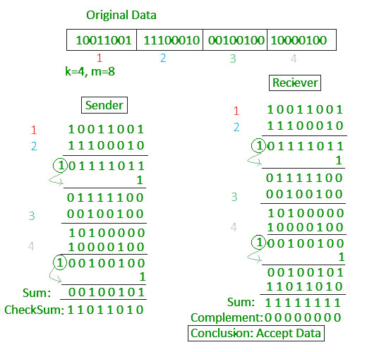
CHECKSUM
Dr. Vivek Rajpoot
Unit-3

Slide 31
Error Correction by Hamming Code
Forward Error Correction (FEC)
The Hamming distance between two words is the number of differences between corresponding bits.
The Hamming distance d(000, 011) is 2 because
The Hamming distance d(10101, 11110) is 3 because
Dr. Vivek Rajpoot
Unit-3

Slide 32
Hamming Code
Hamming code is a set of error-correction codes that can be used to detect and correct the errors that can occur when the data is moved or stored from the sender to the receiver.
Redundant bits: Redundant bits are extra binary bits that are generated and added to the information-carrying bits of data transfer to ensure that no bits were lost during the data transfer. The number of redundant bits can be calculated using the following formula.
2^r ≥ m + r + 1
where, r = redundant bit, m = data bit
Suppose the number of data bits is 7, then the number of redundant bits can be calculated using: = 2^4 ≥ 7 + 4 + 1 Thus, the number of redundant bits= 4
Dr. Vivek Rajpoot
Unit-3

Slide 33
General Algorithm of Hamming Code
Write the bit positions starting from 1 in binary form (1, 10, 11, 100, etc).
All the bit positions that are a power of 2 are marked as parity bits (1, 2, 4, 8, etc).
All the other bit positions are marked as data bits.
Each data bit is included in a unique set of parity bits, as determined its bit position in binary form. a. Parity bit 1 covers all the bits positions whose binary representation includes a 1 in the least significant position (1, 3, 5, 7, 9, 11, etc). b. Parity bit 2 covers all the bits positions whose binary representation includes a 1 in the second position from the least significant bit (2, 3, 6, 7, 10, 11, etc). c. Parity bit 4 covers all the bits positions whose binary representation includes a 1 in the third position from the least significant bit (4–7, 12–15, 20–23, etc). d. Parity bit 8 covers all the bits positions whose binary representation includes a 1 in the fourth position from the least significant bit bits (8–15, 24–31, 40–47, etc). e. In general, each parity bit covers all bits where the bitwise AND of the parity position and the bit position is non-zero.
Check for even parity set a parity bit to 1 if the total number of ones in the positions it checks is odd.
Set a parity bit to 0 if the total number of ones in the positions it checks is even.
Dr. Vivek Rajpoot
Unit-3

Slide 34
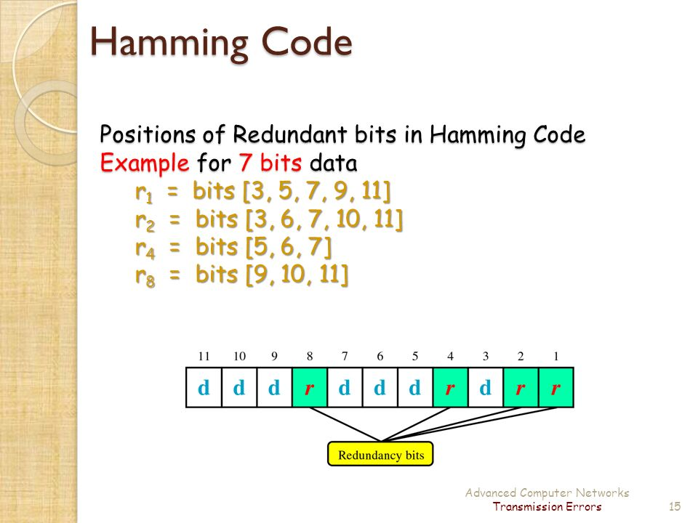
Hamming Code
Dr. Vivek Rajpoot
Unit-3

Slide 35
Flow Control
Flow control is important functions of DL layer, it coordinates the amount of data that can be sent before receiving acknowledgement
Flow control is a set of procedures that tells the sender how much data it can transmit before it must wait for an acknowledgement from the receiver.
Receiver has a limited speed at which it can process incoming data and a limited amount of memory in which to store incoming data.
Receiver must inform the sender before the limits are reached and request that the transmitter to send fewer frames or stop temporarily.
Since the rate of processing is often slower than the rate of transmission, receiver has a block of memory (buffer) for storing incoming data until they are processed.
Flow control Mechanisms
Stop-and-Wait
Go-Back-N ARQ
Selective-Repeat ARQ
Dr. Vivek Rajpoot
Unit-3

Slide 36
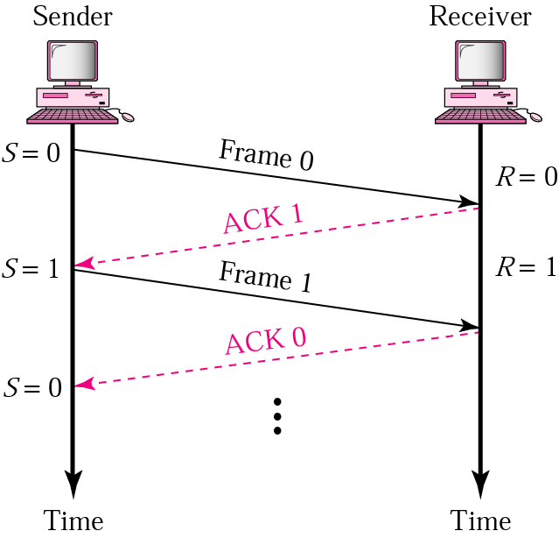
Stop-and-Wait Mechanisms
Sender keeps a copy of the last frame until it receives an ACK.
For identification, both data frames and ACK frames are numbered alternatively 0 and 1.
Sender has a control variable (S) that holds the number of the recently sent frame. (0 or 1)
Receiver has a control variable ® that holds the number of the next frame expected (0 or 1).
Sender starts a timer when it sends a frame. If an ACK is not received within a allocated time period, the sender assumes that the frame was lost and resends it
Receiver send only positive ACK if the frame is intact.
ACK number always defines the number of the next expected frame
Dr. Vivek Rajpoot
Unit-3

Slide 37
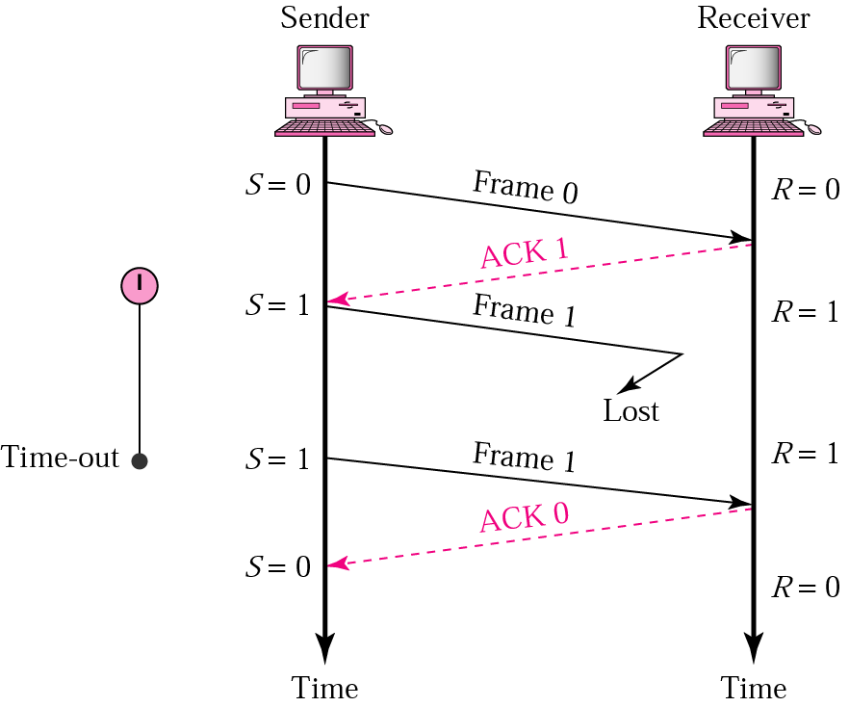
Stop-and-Wait ARQ, lost frame
When a receiver receives a damaged frame, it discards it and keeps its value of R.
After the timer at the sender expires, another copy of frame 1 is sent.
Dr. Vivek Rajpoot
Unit-3

Slide 38
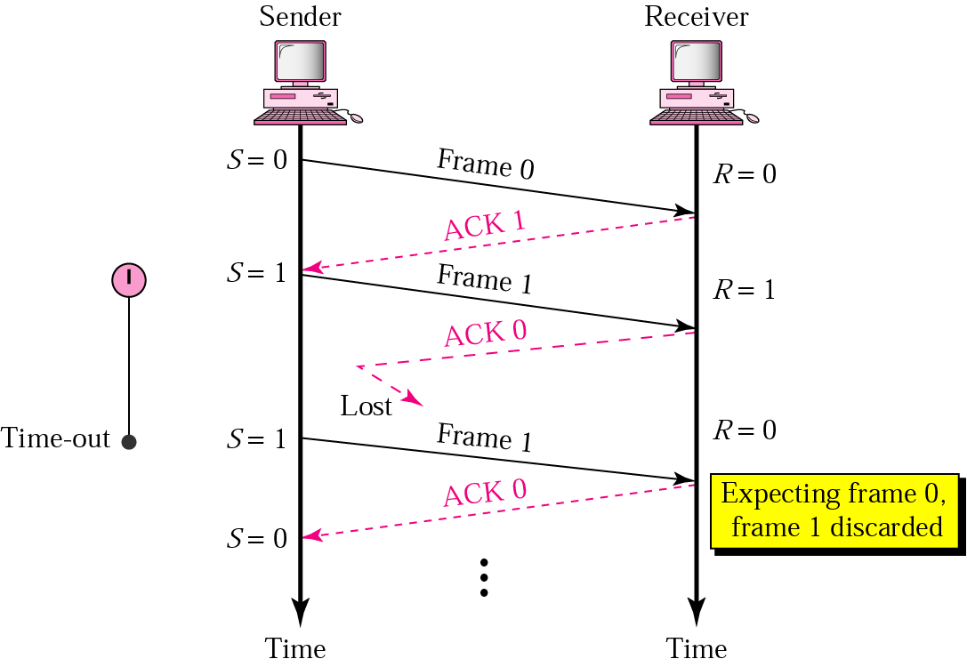
Stop-and-Wait, lost ACK
If the sender receives a damaged ACK, it discards it.
When the timer of the sender expires, the sender retransmits frame 1.
Receiver has already received frame 1 and expecting to receive frame 0 (R=0). Therefore it discards the second copy of frame 1.
Dr. Vivek Rajpoot
Unit-3

Slide 39
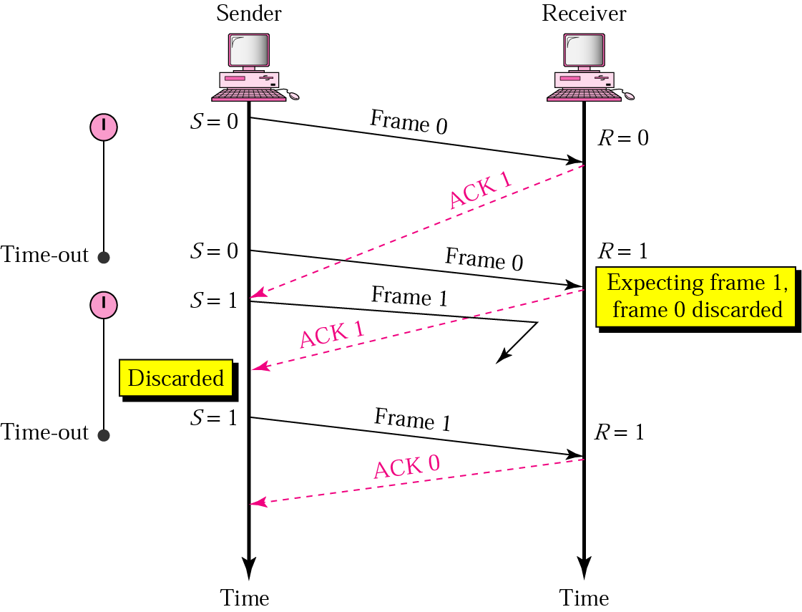
Stop-and-Wait, delayed ACK frame
The ACK can be delayed at the receiver or due to some problem
It is received after the timer for frame 0 has expired.
Sender retransmitted a copy of frame 0. However, R =1 means receiver expects to see frame 1. Receiver discards the duplicate frame 0.
Sender receives 2 ACKs, it discards the second ACK.
Dr. Vivek Rajpoot
Unit-3

Slide 40
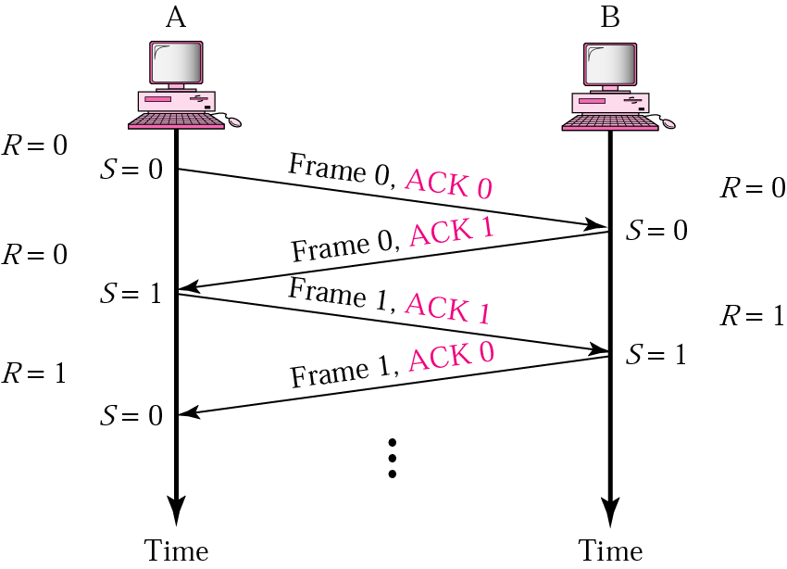
Piggybacking
A method to combine a data frame with ACK.
Station A and B both have data to send.
Instead of sending separately, station A sends a data frame that includes an ACK.
Station B does the same thing.
Piggybacking saves bandwidth.
Dr. Vivek Rajpoot
Unit-3

Slide 41
Disadvantage of Stop-and-Wait
In stop-and-wait, at any point in time, there is only one frame that is sent and waiting to be acknowledged.
This is not a good use of transmission medium.
To improve efficiency, multiple frames should be in transition while waiting for ACK.
Two protocol use the above concept,
Go-Back-N ARQ
Selective Repeat ARQ
Dr. Vivek Rajpoot
Unit-3

Slide 42
Go-Back-N ARQ
We can send up to W frames before worrying about ACKs.
We keep a copy of these frames until the ACKs arrive.
This procedure requires additional features to be added to Stop-and-Wait ARQ.
Sequence Numbers:
Frames from a sender are numbered sequentially.
We need to set a limit since we need to include the sequence number of each frame in the header.
If the header of the frame allows m bits for sequence number, the sequence numbers range from 0 to 2 ^m – 1. for m = 3, sequence numbers are: 0,1, 2, 3, 4, 5, 6, 7.
We can repeat the sequence number.
Sequence numbers are:
0, 1, 2, 3, 4, 5, 6, 7, 0, 1, 2, 3, 4, 5, 6, 7, 0, 1, …
Dr. Vivek Rajpoot
Unit-3

Slide 43
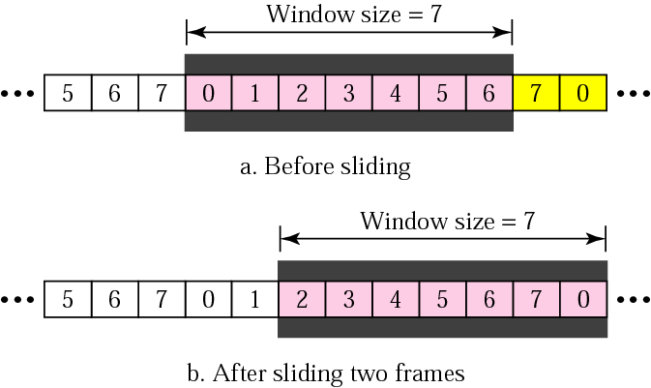
Sender Sliding Window
At the sending site, to hold the outstanding frames until they are acknowledged, we use the concept of a window.
The size of the window is at most 2^{m} -1 where m is the number of bits for the sequence number.
Size of the window can be variable, e.g. TCP.
The window slides to include new unsent frames when the correct ACKs are received
Dr. Vivek Rajpoot
Unit-3

Slide 44
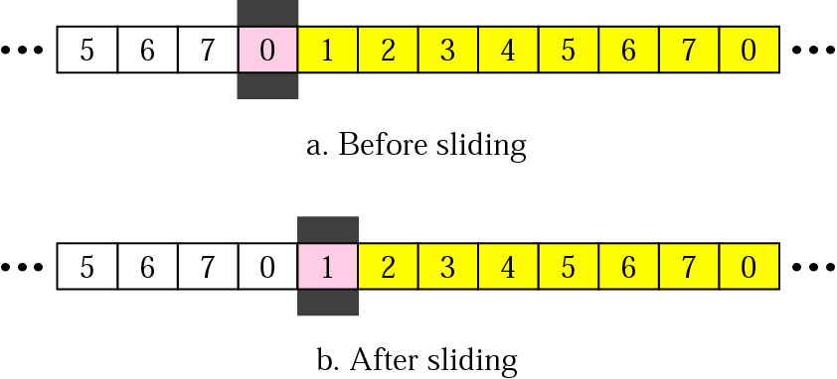
Receiver Sliding Window
Size of the window at the receiving site is always 1 in this protocol.
Receiver is always looking for a specific frame to arrive in a specific order.
Any frame arriving out of order is discarded and needs to be resent.
Receiver window slides as shown in fig. Receiver is waiting for frame 0 in part
Dr. Vivek Rajpoot
Unit-3

Slide 45
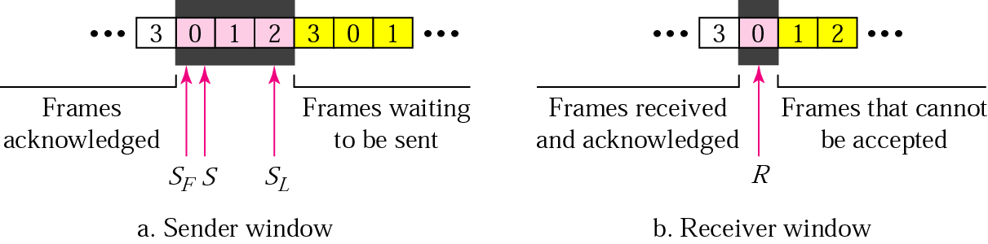
Control Variables
Sender has 3 variables: S, S_{F}, and S_{L}
S holds the sequence number of recently sent frame
S_{F} holds the sequence number of the first frame
S_{L} holds the sequence number of the last frame
Receiver only has the one variable, R, that holds the sequence number of the frame it expects to receive. If the seq. no. is the same as the value of R, the frame is accepted, otherwise rejected.
Dr. Vivek Rajpoot
Unit-3

Slide 46
Acknowledgement
Receiver sends positive ACK if a frame arrived safe and in order.
If the frames are damaged/out of order, receiver is silent and discard all subsequent frames until it receives the one it is expecting.
The silence of the receiver causes the timer of the unacknowledged frame to expire.
Then the sender resends all frames, beginning with the one with the expired timer.
For example, suppose the sender has sent frame 6, but the timer for frame 3 expires (i.e. frame 3 has not been acknowledged), then the sender goes back and sends frames 3, 4, 5, 6 again. Thus it is called Go-Back-N-ARQ
The receiver does not have to acknowledge each frame received, it can send one cumulative ACK for several frames.
Dr. Vivek Rajpoot
Unit-3

Slide 47
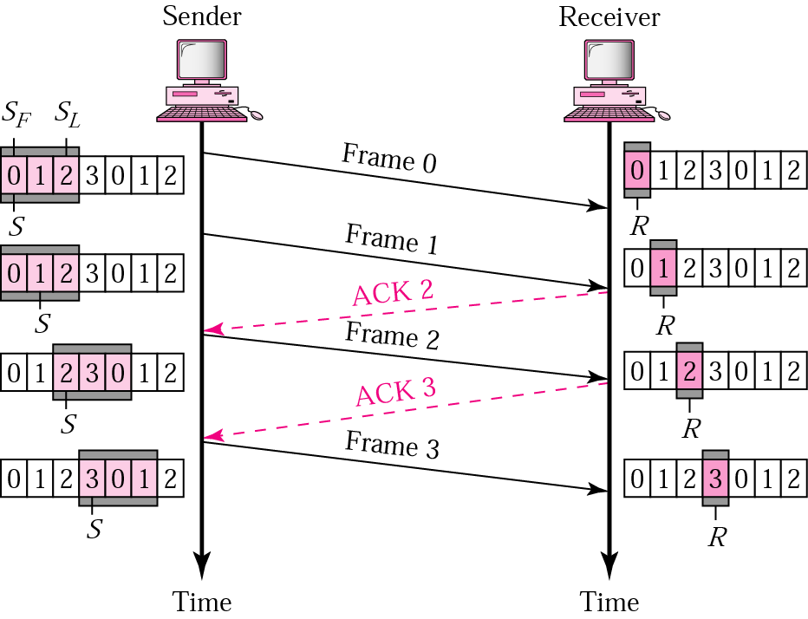
Go-Back-N ARQ, normal operation
The sender keeps track of the outstanding frames and updates the variables and windows as the ACKs arrive.
Dr. Vivek Rajpoot
Unit-3

Slide 48
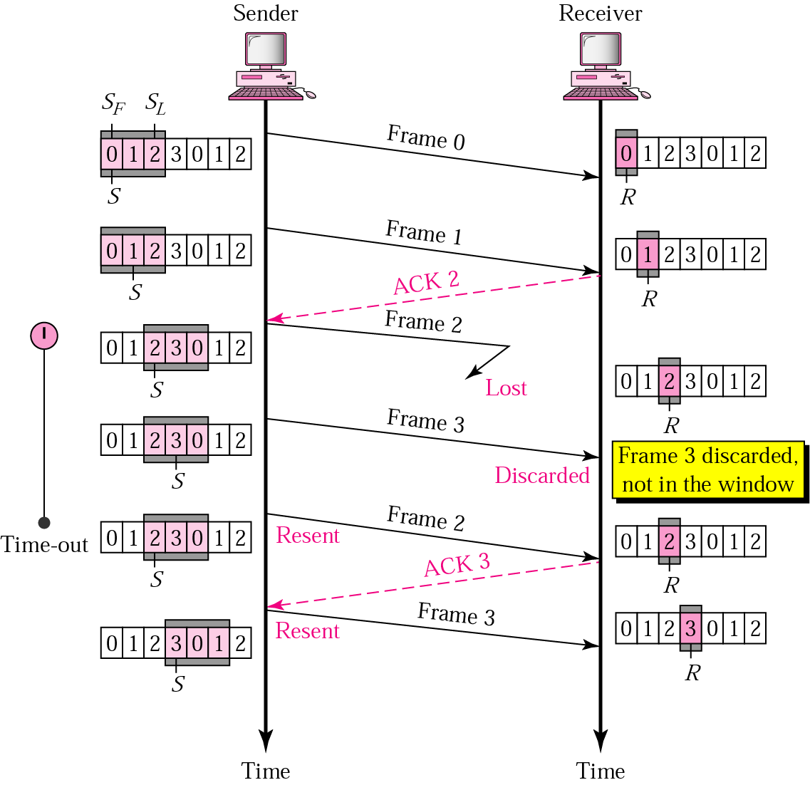
Go-Back-N ARQ, lost frame
Frame 2 is lost
When the receiver receives frame 3, it discards frame 3 as it is expecting frame 2 (according to window).
After the timer for frame 2 expires at the sender site, the sender sends frame 2 and 3. (go back to 2)
Dr. Vivek Rajpoot
Unit-3

Slide 49
Go-Back-N ARQ, damaged/lost/delayed ACK
If an ACK is damaged/lost, we can have two situations:
If the next ACK arrives before the expiration of any timer, there is no need for retransmission of frames because ACKs are cumulative in this protocol.
If ACK1, ACK2, and ACk3 are lost, ACK4 covers them if it arrives before the timer expires.
If ACK4 arrives after time-out, the last frame and all the frames after that are resent.
Receiver never resends an ACK.
A delayed ACK also triggers the resending of frames
Dr. Vivek Rajpoot
Unit-3

Slide 50
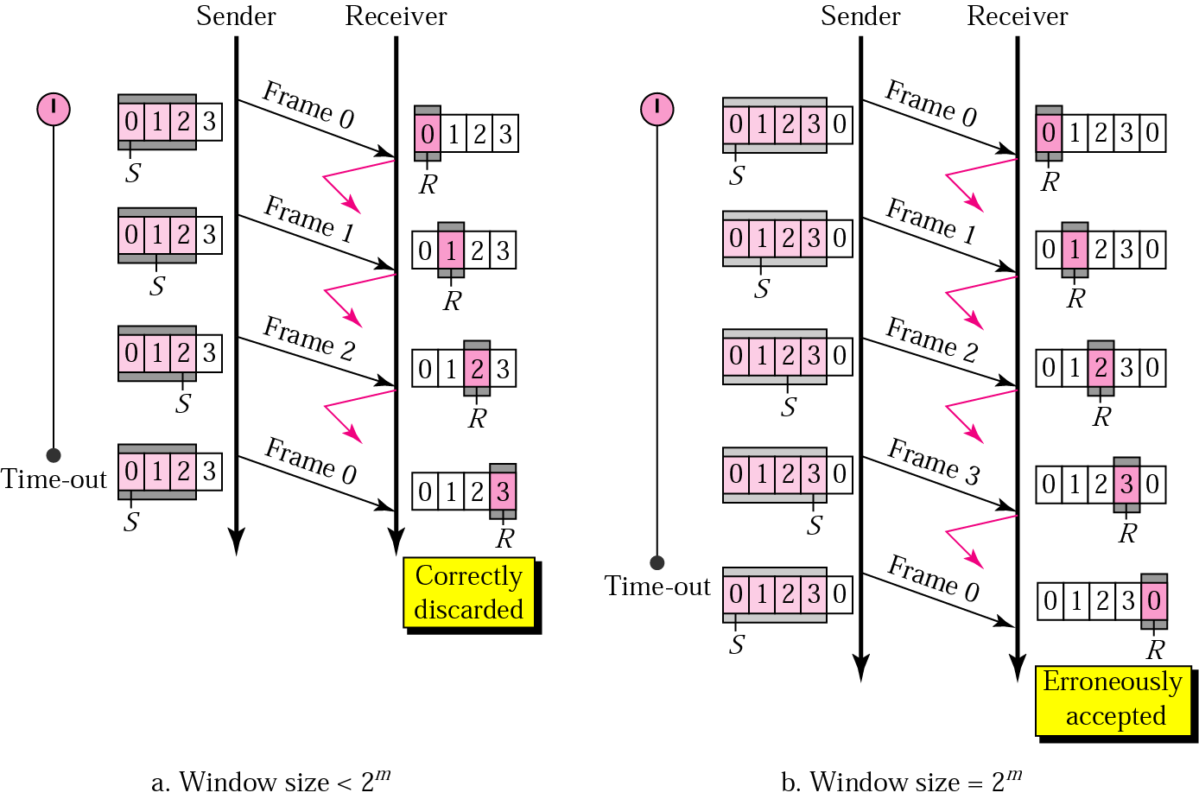
Go-Back-N ARQ, sender window size
Size of the sender window must be less than 2 ^{m}. Size of the receiver is always 1. If m = 2, window size = 2 ^{m} – 1 = 3.
Fig compares a window size of 3 and 4.
Dr. Vivek Rajpoot
Unit-3

Slide 51
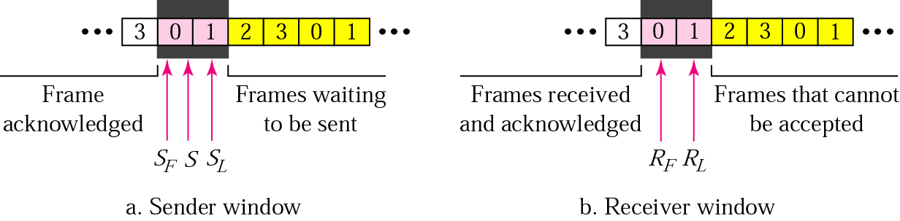
Selective Repeat ARQ, Sender & Rx windows
Go-Back-N ARQ simplifies the process at the Rx site. Receiver only keeps track of only one variable, and there is no need to buffer out-of-order frames, they are simply discarded.
The Protocol is inefficient for noisy link (bandwidth inefficient) & slows down transmission.
In Selective Repeat ARQ, only the damaged frame is resent. More bandwidth efficient but more complex processing at receiver.
It defines a negative ACK (NAK) to report the sequence number of a damaged frame before the timer expires.
Dr. Vivek Rajpoot
Unit-3

Slide 52
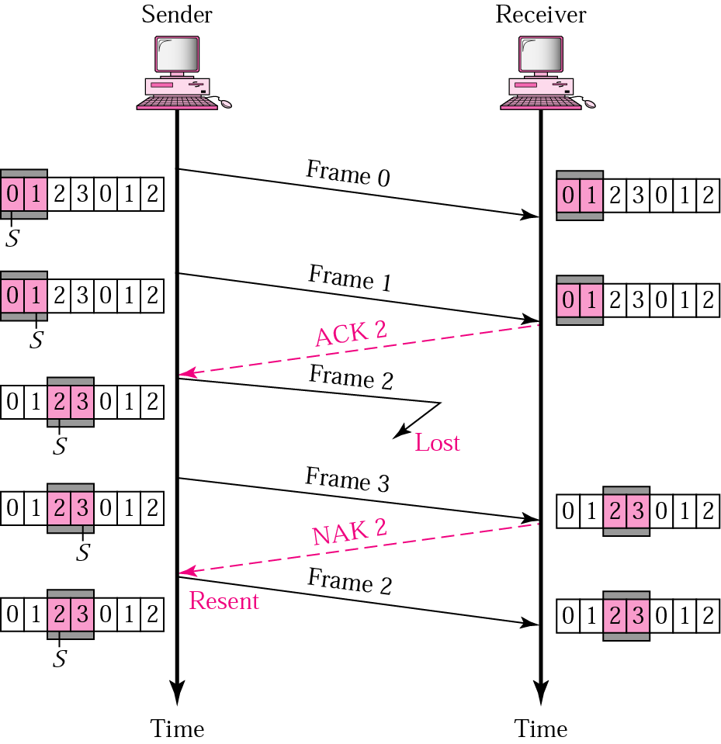
Selective Repeat ARQ, lost frame
Frames 0 and 1 are accepted when received because they are in the range specified by the receiver window. Same for frame 3.
Receiver sends a NAK2 to show that frame 2 has not been received and then sender resends only frame 2 and it is accepted as it is in the range of the window.
Dr. Vivek Rajpoot
Unit-3

